Slide 1



Cybersecurity Training | Consultancy | Software and Professional Services

Slide 2

Who We Are
Motivation
Our Mission, Vision and Purpose
Consultancy
Training Academy
Software Reselling
Professional Services

Slide 3

Who We Are

Slide 4




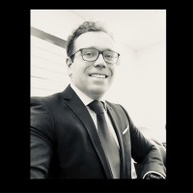
Who We Are
Founder Profile and Leadership
JOSÉ SEQUEIRA MARTINS
EC-COUNCIL ATC (ACCREDITED TRAINING CENTER) MANAGER
EC-COUNCIL TC (TEST CENTER) PROCTOR
EC-COUNCIL C|CISO CERTIFIED CHIEF INFORMATION SECURITY OFFICER
EC-COUNCIL C|EH CERTIFIED ETHICAL HACKER
EC-COUNCIL C|EI CERTIFIED EC-COUNCIL INSTRUCTOR
TUV-SUD ISO27001 LEAD IMPLEMENTER
APQ DPO GDPR PRACTITIONER
CONFIDENCIAL (Several) – CISO CHIEF INFORMATION SECURITY OFFICER
TIMWETECH – CISO CHIEF INFORMATION SECURITY OFFICER
ALTICE – CYBERSECURITY MANAGER
PORTUGAL TELECOM – SOFTWARE/HARDWARE ASSETS AND IT GOVERNANCE DIRECTOR
PORTUGAL TELECOM INFORMATION SYSTEMS UNIT – SOFTWARE DEVELOPMENT DIRECTOR

Slide 5
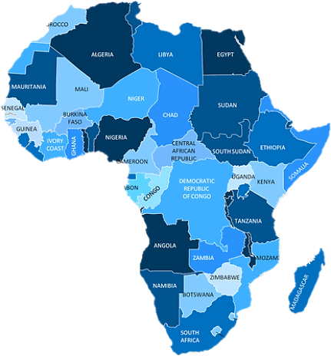
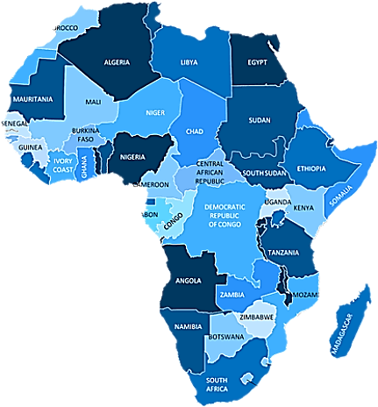
Who We Are
Our Reach… Portugal and Africa
Technical and Commercial Partner, more than 20 years experience in IT, and IT Security at:
Portugal
Algérie
Angola
Benin
Camaroon
Central African Republic
Congo Republic
Democratic Republic of Congo
Egypt
Gabon
Ghana
Ivory Coast
Morocco
Mozambique
Senegal
South Africa
Tunisia

Slide 6

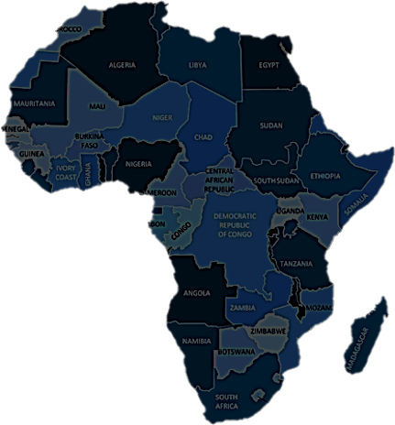
Who We Are
Our Reach… Portugal and Africa
3 months old and already some of our reference customers IN PORTUGAL:
ACCENTURE
AXIANS
OUTSYSTEMS
CGD - CAIXA GERAL DE DEPÓSITOS
AE - AENERGY
TP - TELEPERFOMANCE
JFB - JUNTA DE FREGUESIA DE BENFICA
SIBS - SOCIEDADE INTERBANCÁRIA DE SERVIÇOS
BDP - BANCO DE PORTUGAL
BCP - BANCO COMERCIAL PORTUGUÊS
…

Slide 7


Motivation

Slide 8
CYBERSECURITY SKILLS GAP
Motivation
70%
UNDERSTAFFED
CSX on the State
of Cybersecurity
in 2019
assume they are understaffed on cybersecurity
33%
60%
NEED 6 MONTHS
OPEN JOBS
assume they need at least 6 months to fill-in vacancies
have open positions on cybersecurity
75%
25%
UNDERREPORTED
UNDERQUALIFIED
Breaches are not reported at all, and half (50%) say they do not report even when obliged by law to do it
are underqualified for cybersecurity positions
they offer
60%
of all information security professionals believe their company will be attacked this year

Slide 9






Vision, Mission and Purpose

Slide 10
Vision, Mission and Purpose
Our Vision is living and working in a more Cyber secured World.
Our Mission is to assure an offering that provides companies with the best training academy on cyber-security, the best recognized industry experts to take care of their security needs, and the best software and professional services available.
Our Purpose is to Train and Provide Software, Services and On-Demand Services so we can take the worry and confusion out of running a secure environment and dealing with complex regulatory compliance, leaving companies free to run their own business operations.

Slide 11
Vision, Mission and Purpose
We are experienced professionals who worked in well-known companies on top technical positions of cybersecurity and IT. Each of our pen testers has real senior level experience in penetration testing.
Our work is mostly performed using manual testing approach, we do not only use automatic scanners but incorporate real attack techniques that could be used against an organization. Our reports are written by hand, not auto generated by tools.
All our experience allows us to have a wider view on cybersecurity, we have knowledge from a technical perspective on how hackers operate and what are the biggest cybersecurity threats for today’s world, but also from a management perspective from a CISO point-of-view and speak directly to company board members.

Slide 12
Consultancy

Slide 13





Consultancy
Consultancy for On-Demand Services, Projects, and Auditing, per Profile Type.
CCISO_01
Academy C|CISO
Consultancy / Projects /
Auditing
DPO_02
Academy ISO27K1
Consultancy / Projects /
Auditing
CEH_03
Academy C|EH
Consultancy / Projects /
Auditing
CHFI_04
Academy C|HFI
Consultancy / Projects /
Auditing
…
…
…
…
Full Academy Full Project Full Auditing

Slide 14
Consultancy
The CISO On Demand As A Service:
Most corporations do not to hire a Chief Information Security Officer (CISO), due to many factors, including cost and lack of awareness of such role.
Typical companies have staff that manage their networks and servers, but remain challenged when it comes to understanding their corporation’s security needs
Employing an executive-level can be very cost prohibitive, although many do not need a full-time CISO - all they really need is a trusted advisor, who can provide thought leadership on creating an effective information security cost effectively.

Slide 15
Training Academy

Slide 16
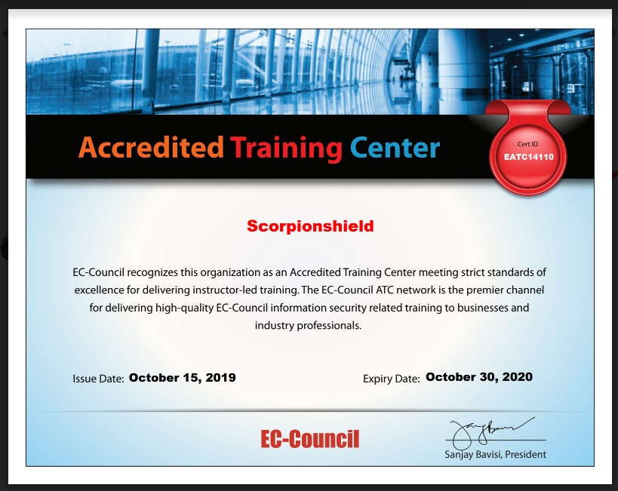


EC-COUNCIL Academy
SCORPIONSHIELD is an active ATC (Accredited Training Center) and Test Center of the EC-COUNCIL, training in Ethical Hacking, InfoSec Leadership CISO, and Digital Forensics.

Slide 17
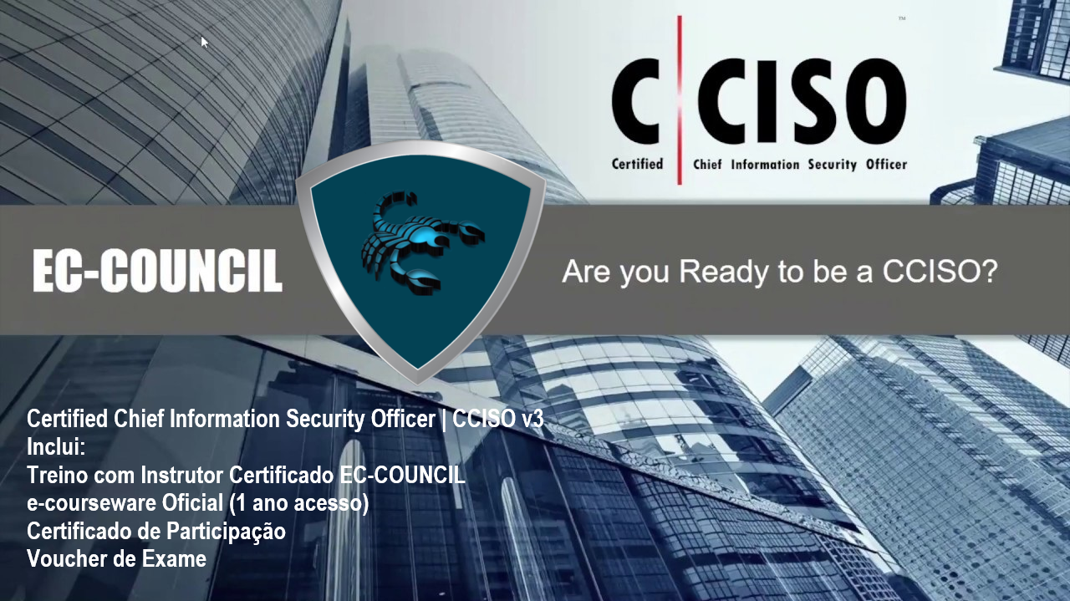
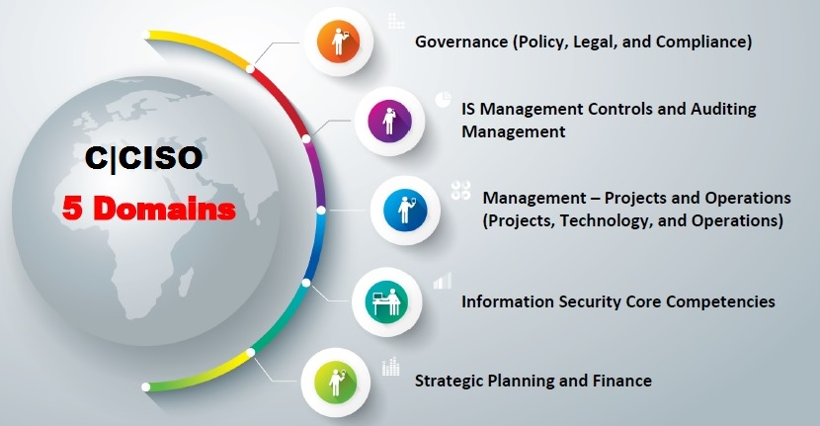
C|CISO Academy

Slide 18
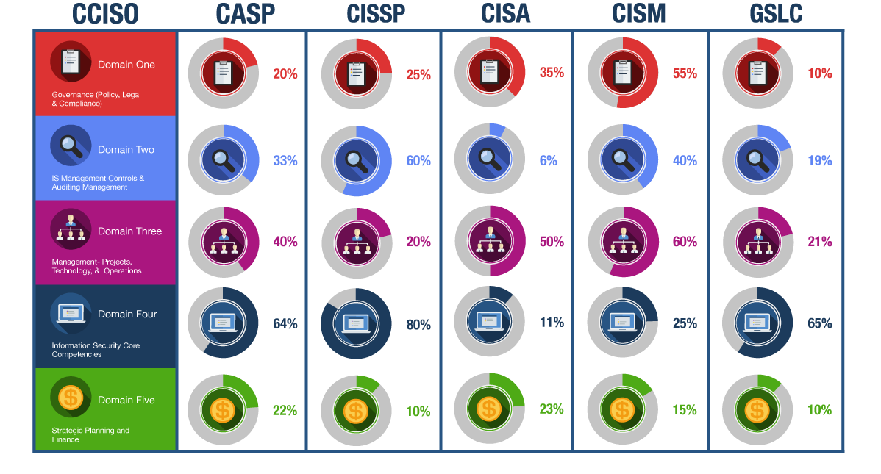
C|CISO Academy

Slide 19



C|EH Academy

Slide 20
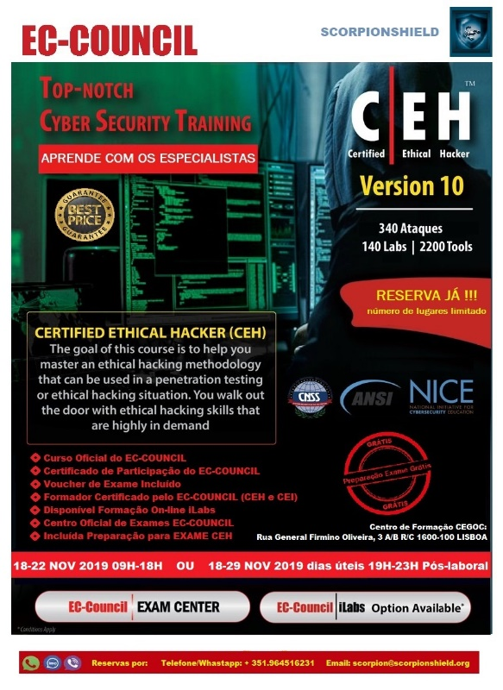
C|EH Academy
The C|EH Certified Ethical Hacker will immerse the participants into an interactive environment, where the consultants show how to scan, test, hack and secure their customers’ systems, through in-depth knowledge and practical experience, understanding how perimeter defenses work and how intruders think and operate.
We examine what organizations are doing to stay relevant and competitive in this fast-paced cybersecurity world, and which ones are doing it best. We then strategize using the best local and global resources, in order to understand the implications of every choice our clients can make. Get in touch about how we can help you.

Slide 21


DPO Academy

Slide 22
DPO Academy
The Data Protection Officer (DPO) is an enterprise security leadership role required by the General Data Protection Regulation (GDPR). DPO’s are responsible for overseeing a company's data protection strategy and its implementation to ensure compliance with GDPR requirements.
Looking to develop your business compliant but not sure where to turn? Need help planning or executing your information security audit? Let us guide you.
Developing a strategy on compliance with the ISO/IEC 27001:2013, or getting help to hatch or maintain a Certification, can be a dauting task.
We are Lead Implementers and Lead Auditors IN the Standard, with recognized work done on several organizations in different industries. Any organization can move towards certification on ISO27001 and increase value for himself and for its customers. We work with small incremental changes, general awareness programs in information security, but building for the future in today’s rapidly evolving environment.

Slide 23
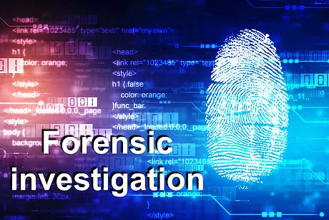
C|HFI Academy

Slide 24
C|HFI Academy
A Computer Forensics Investigator or Forensic Analyst is a specially trained professional who works with law enforcement agencies, as well as private firms, to retrieve information from computers and other types of data storage devices.
Equipment can often be damaged either externally or internally corrupted by hacking or viruses. The Analyst should have an excellent working knowledge of all aspects of the computer including but not limited to hard drives, networking, and encryption.
The C|HFI Certified Computer Hacking Forensics Investigator is the proper expert consultant for detecting hacking attacks and properly extracting evidence to report the crime and conduct audits to prevent future attacks. These techniques are being used by police, government and corporate entities.

Slide 25

Software Reselling
CrowdStrike Partnership

Slide 26
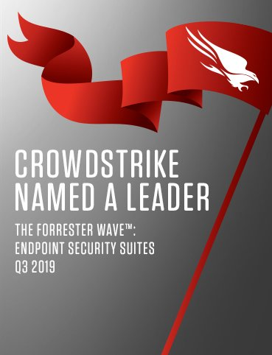
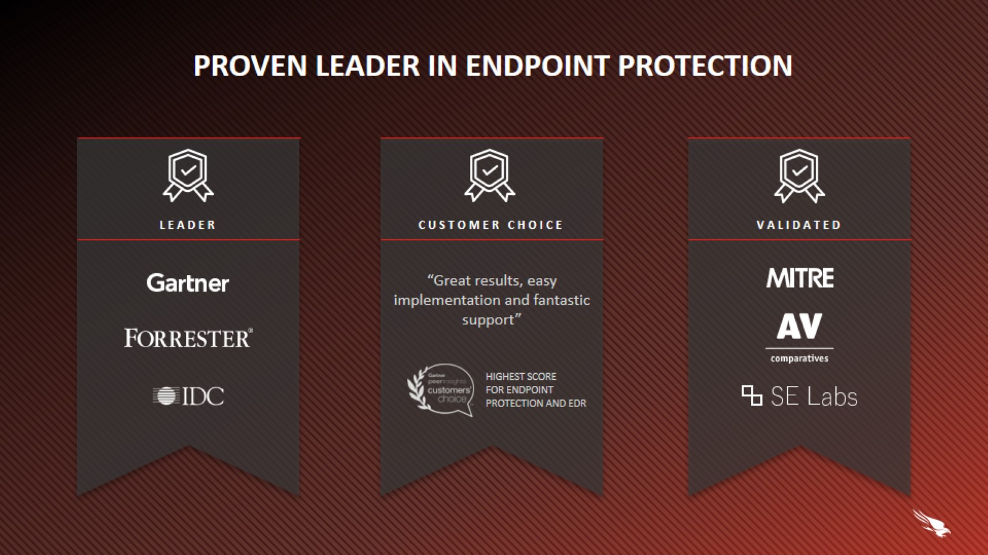
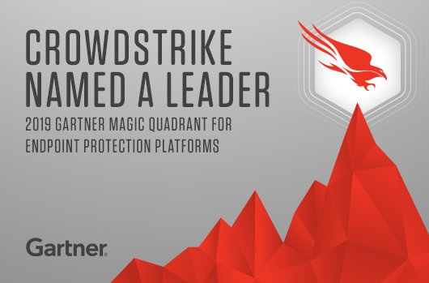
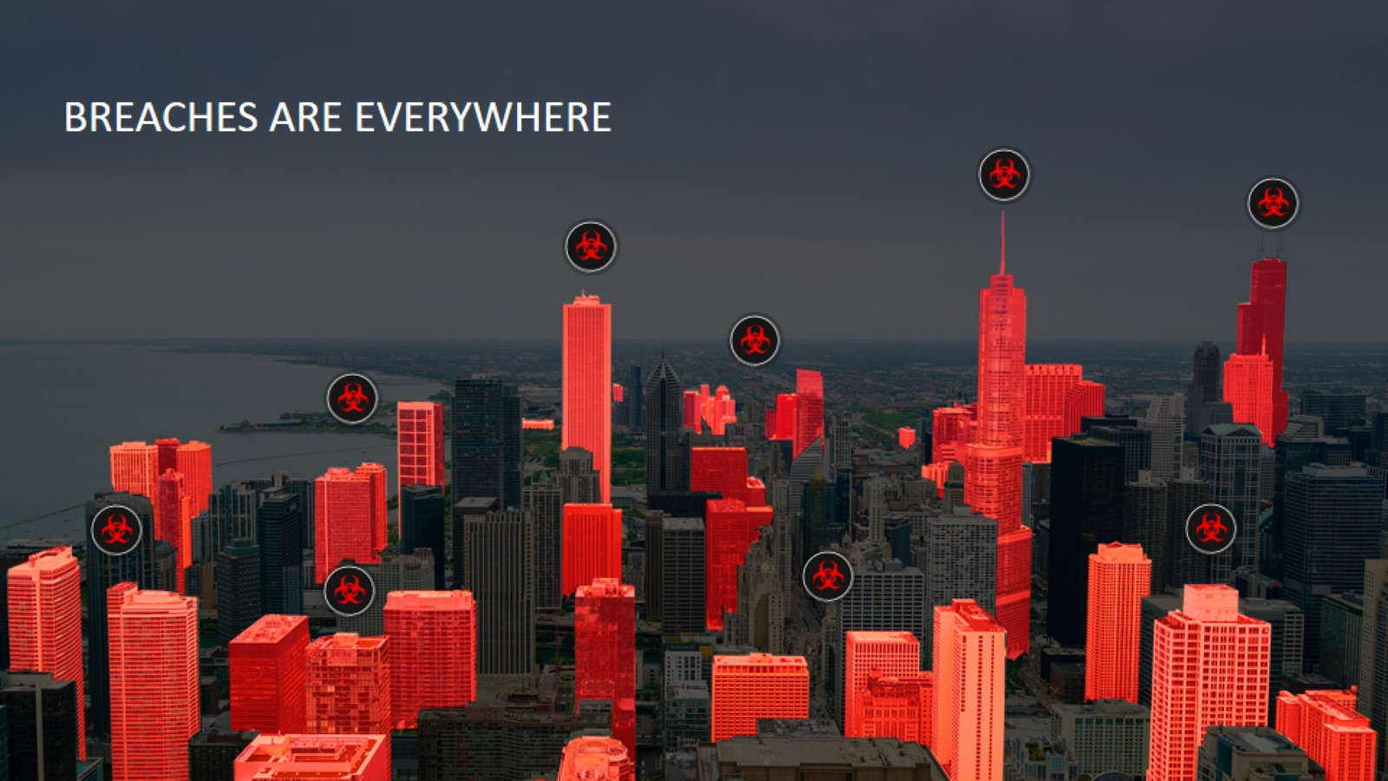
CrowdStrike – Proven Leader

Slide 27
CrowdStrike – Proven Leader
12 of 20
10 of 20
9 of 20
FORTUNE LARGEST GLOBAL COMPANIES
LARGEST FINANCIAL INSTITUTIONS
LARGEST HEALTHCARE PROVIDERS
5 of 10
6 of 10
5 of 10
LARGEST ENERGY COMPANIES
LARGEST TECHNOLOGY COMPANIES
LARGEST MEDIA COMPANIES

Slide 28

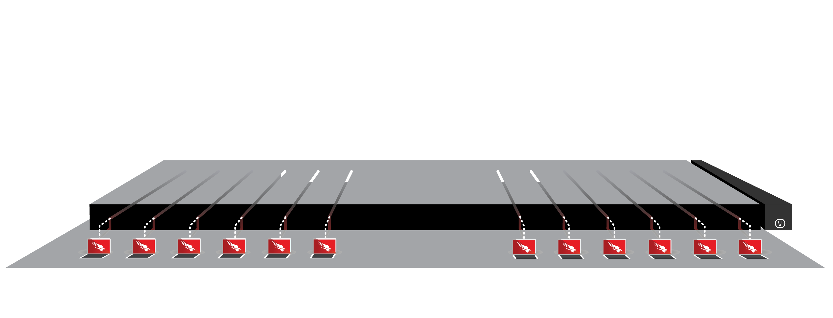












CrowdStrike – Falcon Platform Overview
DEFINING THE SECURITY CLOUD
NEXT-GEN
ANTIVIRUS
EDR
DEVICE
CONTROL
THREAT
HUNTING
IT
HYGIENE
TURNKEY
SECURITY
VULNERABILITY
MANAGEMENT
THREAT
INTEL
MALWARE
SEARCH
MALWARE
ANALYSIS
Falcon
Prevent
Falcon
Insight
Falcon
Device Control
Falcon
OverWatch
Falcon
Discover
Falcon
Complete
Falcon
Spotlight
Falcon
X
Falcon
Search
Falcon
Sandbox
CROWDSTRIKE STORE
ENDPOINT SECURITY
SECURITY & IT OPERATIONS
THREAT INTELLIGENCE
THREAT GRAPH
APIs
LIGHTWEIGHT AGENT
Notes:
Our unique combination of technology, intelligence and expertise comes together in a comprehensive platform for endpoint security. CrowdStrike Falcon Platform is the industry’s first true security cloud.
It combines endpoint protection using highly refined AI/ML to deliver next-gen AV, best-in-class EDR, and integrated device control
It delivers security operations capabilities including IT hygiene, vulnerability assessment, , managed endpoint protection and managed threat hunting.
It's powered by world-class threat intelligence, including malware search and sandbox analysis that is fully integrated and automated, delivering deep context and predictive capabilities.
Our platform was brings nearly limitless extensibility, allowing you to leverage that single agent and single platform to deliver outcomes that go beyond endpoint security. We make it easy for you to extend your investment through the CrowdStrike Store, a marketplace where you can discover, try, buy and deploy trusted partner applications that build on the Falcon platform. The CrowdStrike Store lets you build your own security ecosystem, and snap it together like Lego bricks, eliminating months of effort involved in deploying and integrating solutions on your own.

Slide 29


Falcon Solutions
FALCON ENDPOINT PROTECTION SOLUTIONS
FALCON PRO
FALCON ENTERPRISE
FALCON PREMIUM
FALCON COMPLETE
Next Gen Antivirus
Remote Response
Integrated Threat Intel
Next Gen Antivirus
Endpoint Detection & Response
Integrated Threat Intel
Managed Threat Hunting
Device Control
Next Gen Antivirus
Endpoint Detection & Response
Integrated Threat Intel
Premium Hunting Service
Device Control
IT Hygiene
Falcon Endpoint Protection
Delivered As A Service
Backed By $1M Warranty
Notes:
Here’s a closer look at FALCON ENDPOINT PROTECTION PRO

Slide 30
Falcon EndPoint Protection PRO
BUSINESS VALUE
Integrated
Threat Intelligence
Next Generation Antivirus (AV)
Replace legacy antivirus solutions
Stop known and unknown malware
Remediate incidents quickly
Restore system performance and productivity
Empower analysts to operate more efficiently
Full Attack
Visibility
Real Time
Response
Notes:
Here’s a closer look at FALCON ENDPOINT PROTECTION PRO

Slide 31
Falcon EndPoint Protection ENTERPRISE
BUSINESS VALUE
Integrated
Threat Intelligence
Next Generation Antivirus (AV)
Unify NGAV and EDR for full endpoint protection
Enable threat hunting and real time visibility
Uncover stealthy attacks
Speed investigation and response
Automatic analysis and orchestrated IOC sharing
Managed
Threat Hunting
Endpoint Detection
and Response (EDR)
Notes:
Here’s a closer look at FALCON ENDPOINT PROTECTION ENTERPRISE

Slide 32
Falcon EndPoint Protection PREMIUM
BUSINESS VALUE
Integrated
Threat Intelligence
& IT Hygiene
Next Generation Antivirus (AV)
Protection that unifies NGAV, EDR and IT Hygiene
Premium threat hunting adds guided remediation
Expanded visibility & control
Analysts empowered by real time visibility and threat intel
Discover unprotected systems, risky applications
and users
Premium Managed
Threat Hunting
Endpoint Detection
and Response (EDR)
Notes:
Here’s a closer look at FALCON ENDPOINT PROTECTION PREMIUM

Slide 33
Falcon COMPLETE
BUSINESS VALUE
Prevention
and Detection
Implementation
24/7 Managed Endpoint Security
Simplifies and Optimizes Endpoint Security
Force Multiplier
Back to Business Swiftly with Managed Remote Remediation
Up to USD 1 M Warranty
Remote Remediation
Delivered
as a Service
Notes:
Here’s a closer look at FALCON COMPLETE

Slide 34
Professional Services
CrowdStrike Partnership

Slide 35

Professional Services
BUSINESS VALUE
AM I BREACHED?
INCIDENT
RESPONSE SERVICES
TECHNICAL
ADVISORY SERVICES
Improve your security posture
Clear & actionable advice
STRATEGIC
ADVISORY SERVICES
Fast & effective delivery
Range & reach of services offered
AM I
READY?
AM I MATURE?
All services available as a retainer
Notes:
Our services offerings are broken down into three different areas of expertise. Am I Breached, Am I Mature and Am I Ready. Services offerings under Am I Breached include our Incident Response and compromise assessments, our technical advisory services fall under Am I Mature, and our strategic advisory services offer organizations coaching and security training to help them answer the question - Am I Ready.
Many top Fortune companies turn to CrowdStrike services because we offer such a wide range of both IR and Strategic advisory services, all of which are delivered quickly and effectively– providing clear and actionable advice to help strengthen their security posture.

Slide 36
Professional Services
AM I BREACHED?
AM I MATURE?
AM I READY?
Incident Response
Compromise Assessment
Business Email Compromise Assessment (BECA)
Merger & Acquisition Cyber Risk Assessment
Falcon Network as a Service
Cybersecurity Maturity Assessment
IR Policy, Plan & Playbook Development
Security Assessments
Red Team Blue Team Exercise
Tabletop Exercises
Live War Games
Red Team Operations
Adversary Emulation Exercise
All services offerings are available under a retainer
Notes:
To expand on our offerings – here is a bit more on each services category– Am I Breached, Am I Mature, Am I Ready. We offer best in class Incident Response and Compromise assessments along with an array of strategic advisory services that allow an organization to enhance and improve their security posture and reduce risk.
To begin the discussion we will review the offerings under “Am I Breached.” Our Incident Response and Compromise Assessment offerings are designed to investigate and detect whether or not a network or endpoint has been compromised. Business Email Compromise Assessments help an organization determine if an email has been or could be the source on an incident. And our M&A Cyber Risk Assesment help organization gain full insight into a third party organization’s network before a transaction takes place. Our Falcon product coupled with our team’s years of in-depth hunting and investigative experience will quickly be able to identify any sign of compromise within an environment.
Next - CrowdStrike Services is here to assist organizations as they confront the question of ‘Am I Mature’? In this context, an organization is looking to ensure that programmatically they have the processes and procedures at hand to address attacks and incidents. We have a wide range of offerings in this area that can assist an organization. A Cyber Maturity Assessment is always a good place to start. This provides an independent assessment as to an organizations capabilities, skills and procedures – allowing them to address and prioritize areas for improvement. We can assist in developing IR policy and playbooks to ensure that a organization is ready to effectively and efficiently handle any incident, should it come to pass. The Cloud is a reality for the majority of organizations. It brings many benefits, but it also raises security concerns and questions. Just how secure or mature is your Cloud infrastructure? Well, CrowdStrike Services can help you answer that question and guide you as to how you can effectively secure your Cloud. Finally, Attackers are laser focused on securing credentials that allow them to move laterally across the environment and hide within it. With that in mind, ensuring that the credentials held and administered within Active Directory is vital. CrowdStrike Services can help an organization assess the security of AD and provide detailed guidance and help as to how it can be better protected.
Finally, the last step in the maturity model is focused on ‘Am I ready’. Here the approach is to provide help to ensure the organization is primed and prepared to protect itself against attacks and intrusions. We can run Red Team operations to determine the effectiveness of an organizations technology and processes in detecting attacks and intrusion. What would a targeted attack be like? Can you get your internal team to understand what happens during an incident response situation? With our table-top exercises we guide an organization—both executive and technical participants—through a targeted attack scenario and uncovers the gaps that only arise when an actual incident occurs. Lastly, Falcon Network is a network monitoring security service that utilizes both the expertise of CrowdStrike Services threat hunters and a virtual network appliance that detects threats present in a customer’s environment.

Slide 37

Contacts
http://www.scorpionshield.pt
http://www.scorpionshield.org
http://www.thescorpionshield.com
scorpion@scorpionshield.org
Headquarters: Rua Latino Coelho 87, 1050-180 Lisboa - Portugal
Training Center: Av. Fontes Pereira de Melo 17 3º andar, 1050-116 Lisboa - Portugal

